Slide 1
Developing External Tools for Power BI Desktop
Ted Pattison
Principal Program Manager
Power BI Customer Advisory Team (PBICAT)

Slide 2
Agenda
Developing External Tools for Power BI Desktop
Exploring Dev Camp External Tool Demo App
Programming the Tabular Object Model (TOM)
Adding Productivity Features to an External Tool
Extending Translations Builder

Slide 3
Developing an External Tool for Power BI Desktop
Power BI Desktop provides support for integrating external tools
External tool can be launched from Power BI Desktop
External tool designed to connect directly to dataset in local AS engine session
External tool can be designed to create, read, update and delete dataset objects
External tools are programmed using Tabular Object Model (TOM)
Local Desktop Setup on Windows PC
Your_External_Tool.exe
Power BI Desktop
Custom C# Code
Local Analysis Services Engine
Dataset
Tabular Object Model
localhost:55074
XMLA Endpoint
.NET 6 Runtime

Slide 4
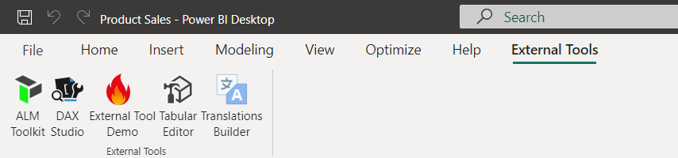
External Tools Integration with Power BI Desktop
Once installed, external tool becomes available through External Tools tab
Click on tile for external tool to launch it and connect to dataset
Popular External Tools available for free through Power BI Community
Tabular Editor 2
DAX Studio
ALM Toolkit
Translations Builder
Bravo

Slide 5
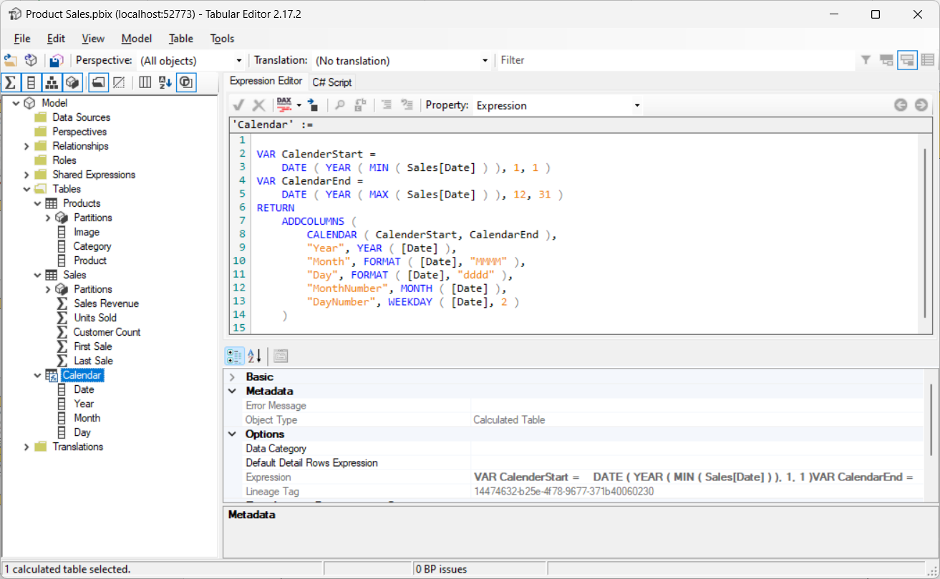

Working with Tabular Editor 2
Tabular Editor provides advanced data modeling not possible in Power BI Desktop
User can add advanced modeling features by hand
User can automate adding advanced modeling features using advanced scripting
Download version 2 from https://github.com/otykier/TabularEditor/
Creator: Daniel Otykier

Slide 6
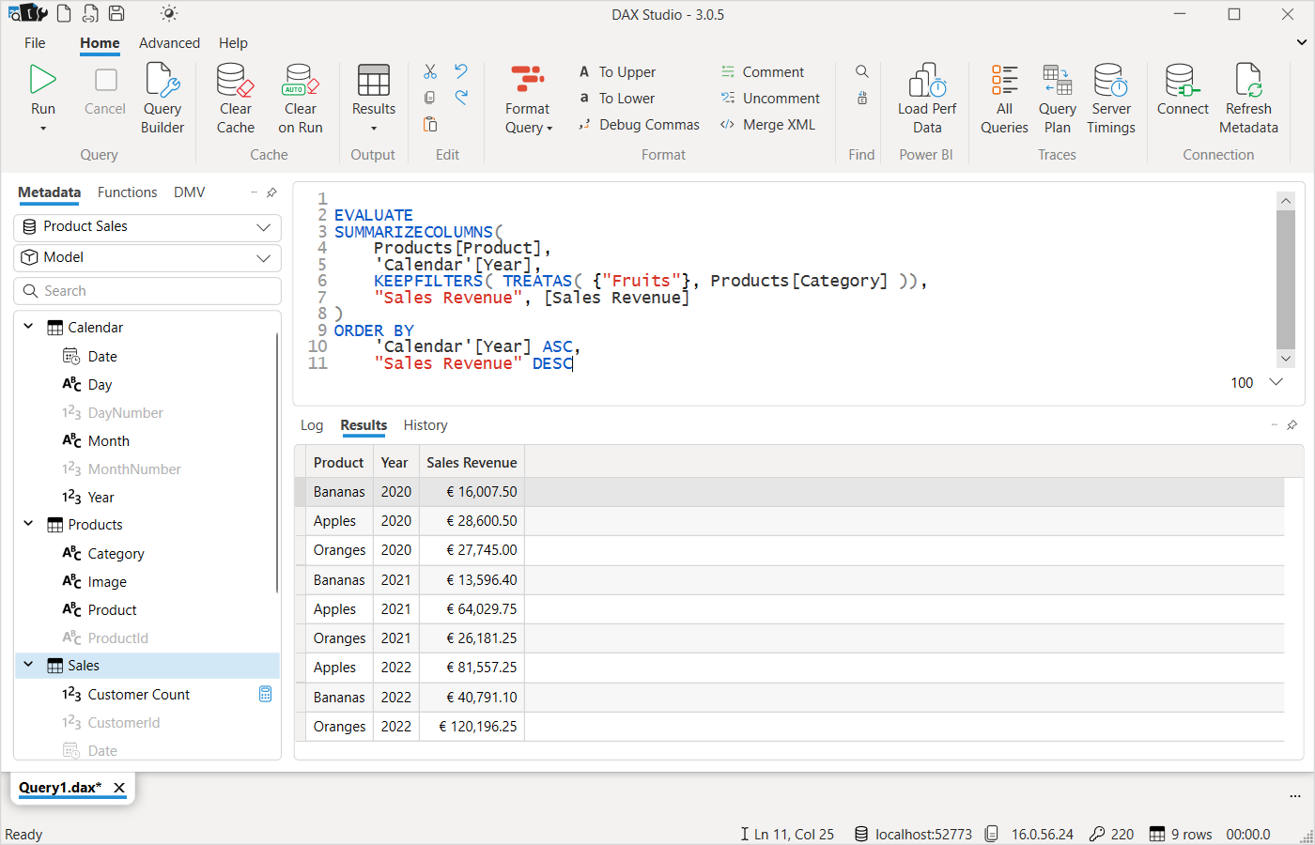

Working with DAX Studio
DAX Studio provides advanced data modeling tool to write and test DAX queries
Powerful tool for monitoring and optimizing query performance
Download from https://daxstudio.org/
Creator: Darren Gosbell

Slide 7
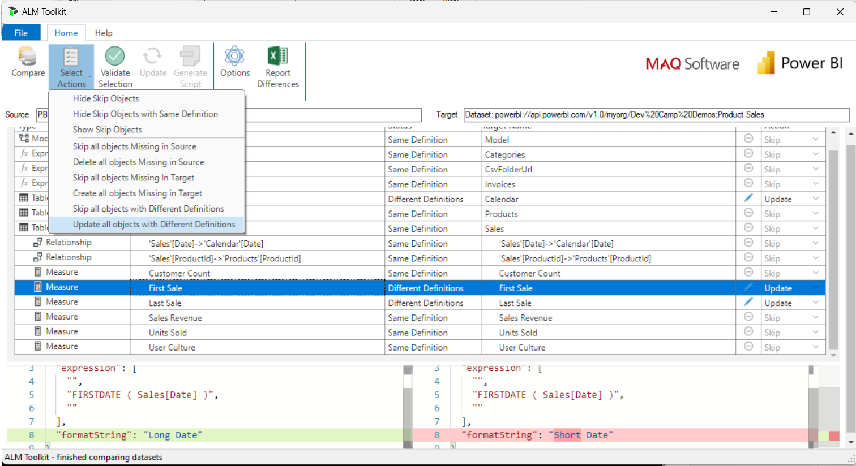

Working with ALM Toolkit
ALM Toolkit provides tool for deploying and updating datasets
Allows user to compare datasets in Power BI Desktop and Power BI Service
Provides support to push new dataset objects and updates to production datasets
Download from http://alm-toolkit.com/
Creator: Christian Wade

Slide 8
Two Connection Models for External Tool Development
Model #1: Connect to dataset running locally in Power BI Desktop loaded from PBIX file
Your code can only access a subset of what’s available in Tabular Object Model (TOM)
Model #2: Connect to datasets running remotely in the Power BI Service
Your code has full access to what’s available in Tabular Object Model (TOM)
Tabular
Editor
Power BI Desktop
PBIX Project File
Dataset
Your Custom External Tool
Tabular
Editor
Power BI Service
Premium Workspace
XMLA
Endpoint
Dataset
Your Custom External Tool

Slide 9
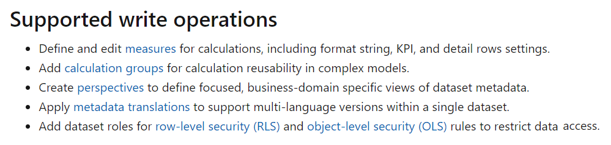
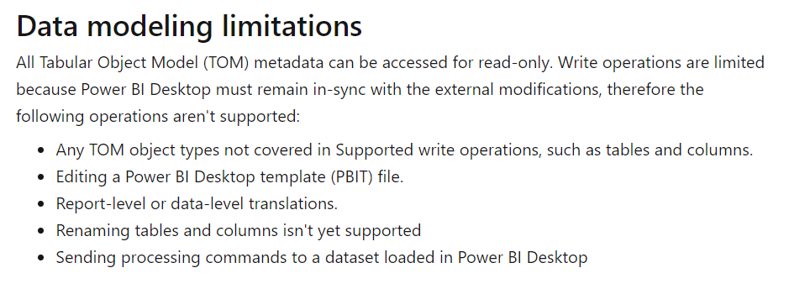
Microsoft Documentation for Model #1
https://learn.microsoft.com/en-us/power-bi/transform-model/desktop-external-tools

Slide 10
Considerations for the Two Connection Models
Model #1 allows you to update PBIX file and check it into source control
Model #2 prevents ability to download dataset as PBIX file
Model #2 provides opportunities to create advanced ALM and deployment processes
Power BI Desktop
Azure DevOps Repository
PBIX File
Your Custom External Tool
Dataset
PBIX File
Version 2.3
Power BI Service
Premium Workspace
Exported
PBIX File
Your Custom External Tool
Dataset
Export
Local Dataset
ALM Toolkit
Production Dataset
Push Dataset Updates into Production

Slide 11
Agenda
Developing External Tools for Power BI Desktop
Exploring Dev Camp External Tool Demo App
Programming the Tabular Object Model (TOM)
Adding Productivity Features to an External Tool
Extending Translations Builder

Slide 12
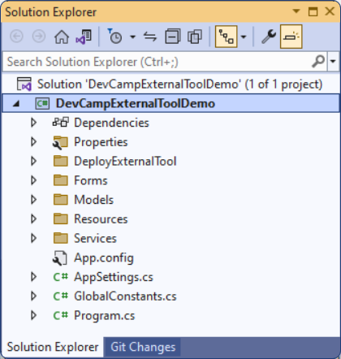
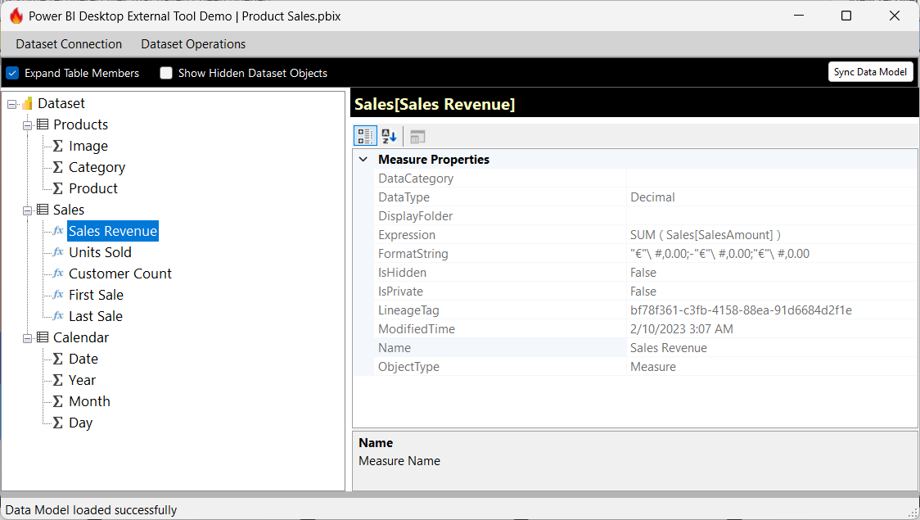
The DevCampExternalToolDemo Project
DevCampExternalToolDemo project demonstrates simple external tool
Created using Visual Studio 2022, C#, .NET 6 and Windows Forms
You can use it as starter project for developing your own external tool
You can use it as a learning tool to get up the learning curve with external tool development
Download from https://github.com/PowerBiDevCamp/DevCampExternalToolDemo

Slide 13
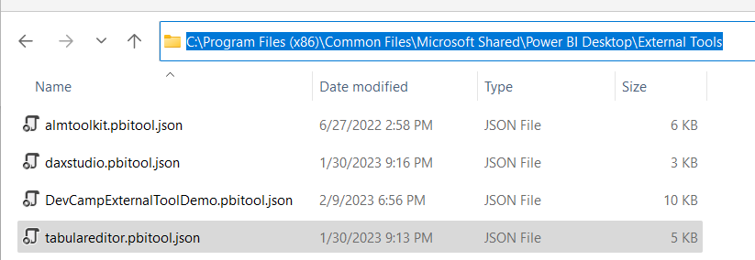
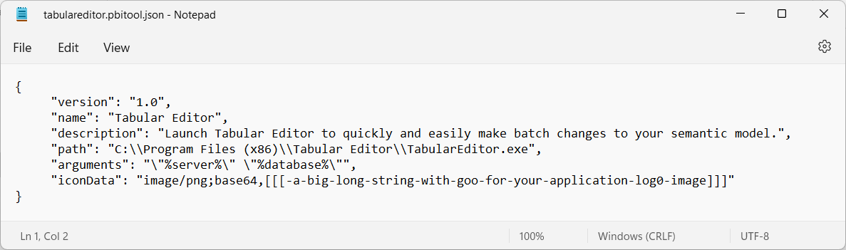
External Tool Deployment
External Tools deployed by copying JSON file to External Tools folder
Deployment file must be named with pbitool.json extension such as tabulareditor.pbi.json
File copied to C:\Program Files (x86)\Common Files\Microsoft Shared\Power BI Desktop\External Tools
pbi.json file for external tool tracks name, EXE path, arguments and icon data

Slide 14
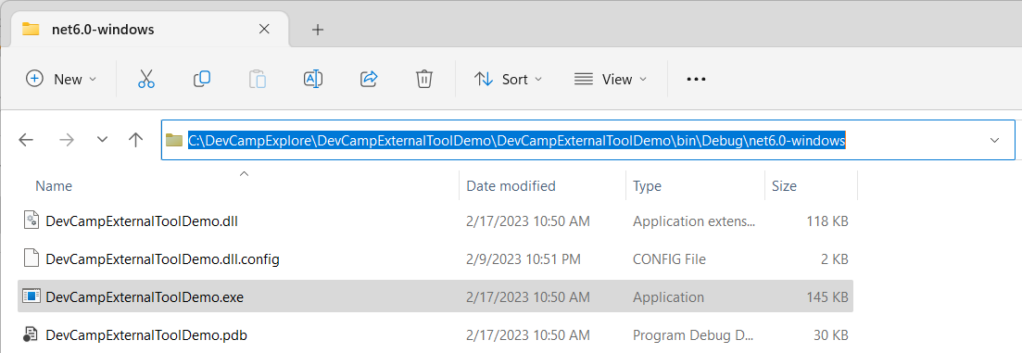
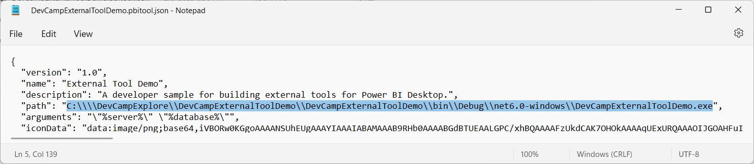
External Tool Deployment for Development
Developer can update pbi.json file for development-time usage
Visual Studio builds project output with debug version of EXE in local bin\Debug folder
Update pbi.json file to point to EXE in in bin\Debug file to run tool in Visual Studio debugger

Slide 15
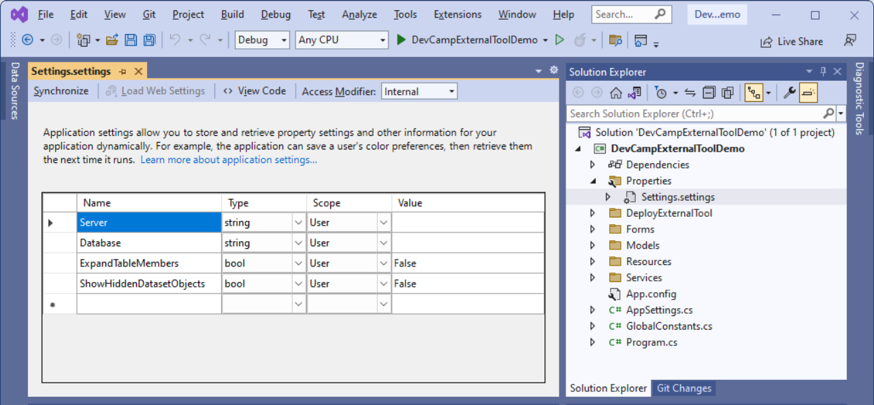
Tracking Application Settings on aUser-By-User Basis
.NET platform providers Application settings to persist settings for current user
Demo includes settings for Server, Database, ExpandTableMembers & ShowHiddenDatasetObjects

Slide 16
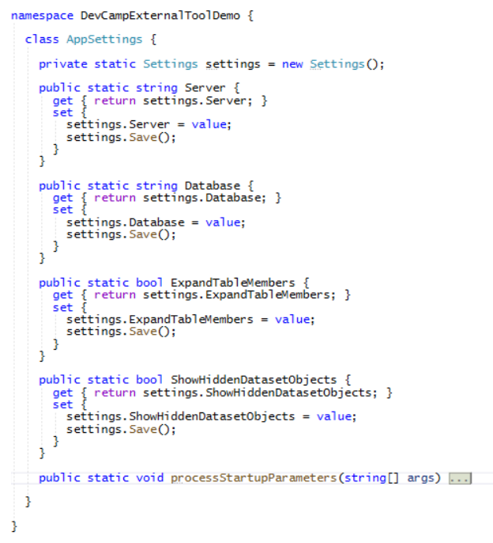
AppSettings Class Acts as Wrapper for .NET Settings Class

Slide 17
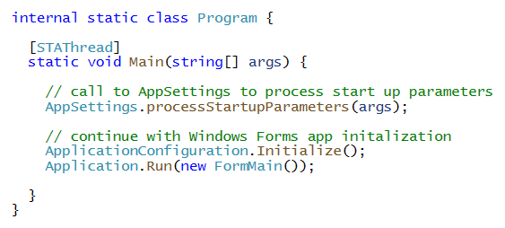
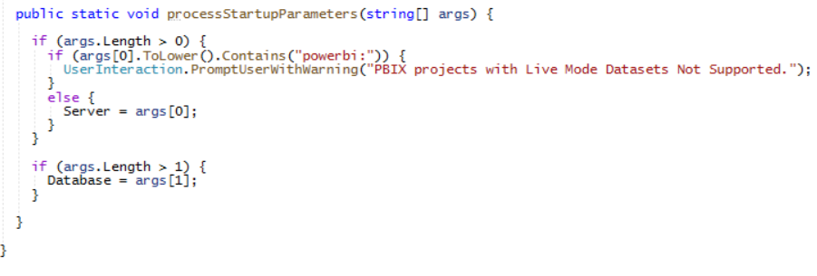
External Tool Launched with Startup Parameters
When user launches an external tool from Power BI Desktop…
Power BI Desktop passes string array parameter to EXE at start up
Demo uses processStartupParameters function in AppSettings class to process parameters
First parameter (args[0]) passes Server connect string in form of localhost:60042
If PBIX file references remote dataset, Server parameter contains powerbi:
Server parameter stored as Server application setting for current user during development

Slide 18
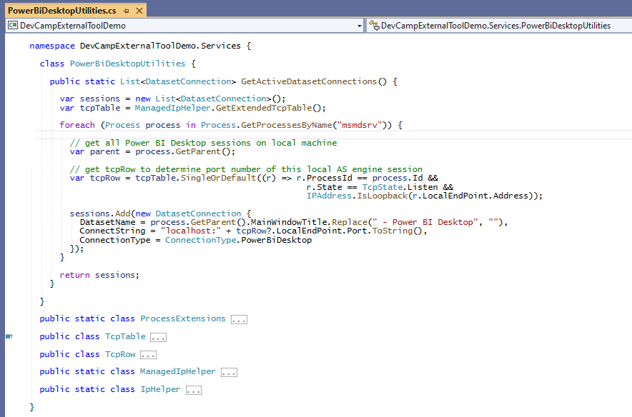
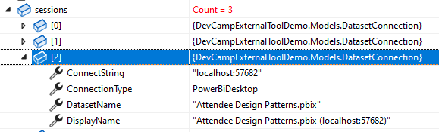
PowerBiDesktopUtilities
PowerBiDesktopUtilities.cs provides assistance with connecting to datasets
It contains low-level code to detect running instance of Power BI Desktop
It uses Windows API to read PBIX project file name from main window of Power BI Desktop
GetActiveDatasetConnections returns list of active Power BI Desktop sessions on local PC

Slide 19
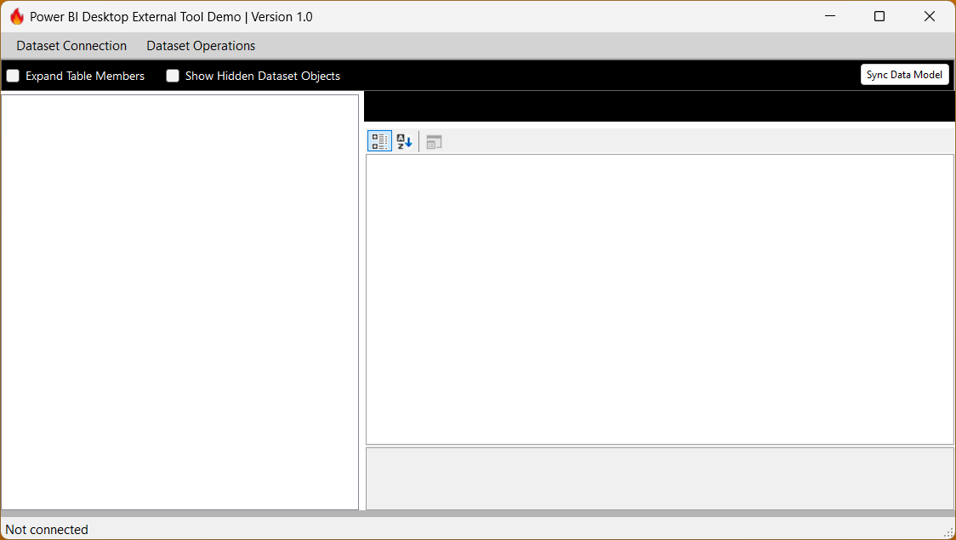
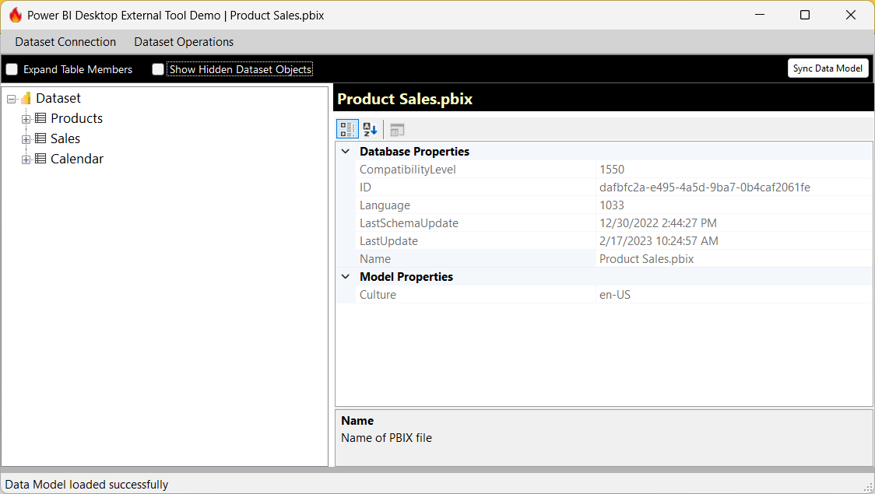
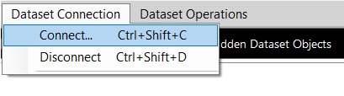
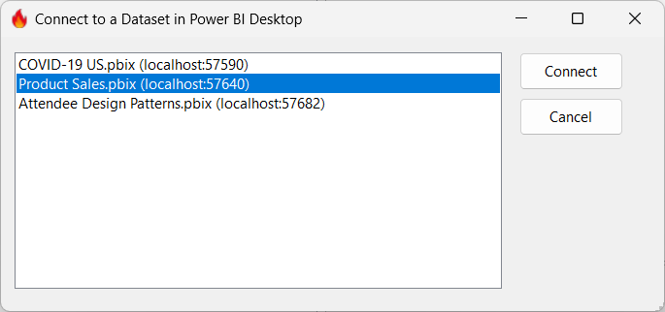
Connecting to a Power BI Desktop Session

Slide 20
Agenda
Developing External Tools for Power BI Desktop
Programming the Tabular Object Model (TOM)
Adding Productivity Features to an External Tool
Extending Translations Builder

Slide 21
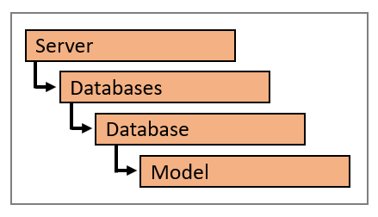
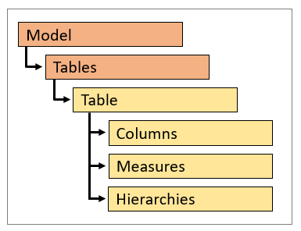
Programming Dataset Objects using TOM
TOM provides a set of programmable objects to read & updates dataset definitions
Power BI workspace represented in TOM with a Server object
Power BI dataset represented in TOM with a Database object
Data model inside dataset represented in TOM with Model object
Model object provides access to dataset objects

Slide 22
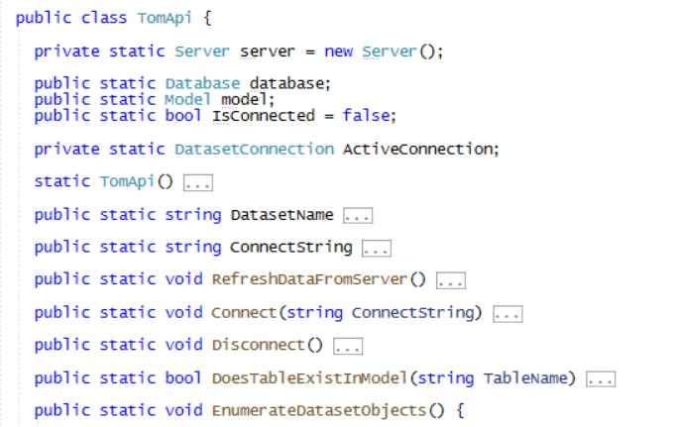
TomApi Class
DevCampExternalToolDemo project includes TomApi class
This class contains C# code demonstrating TOM programming techniques

Slide 23
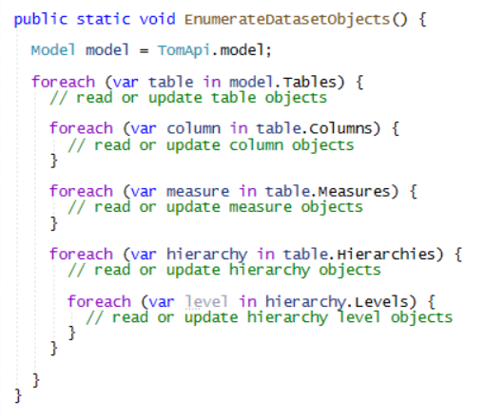
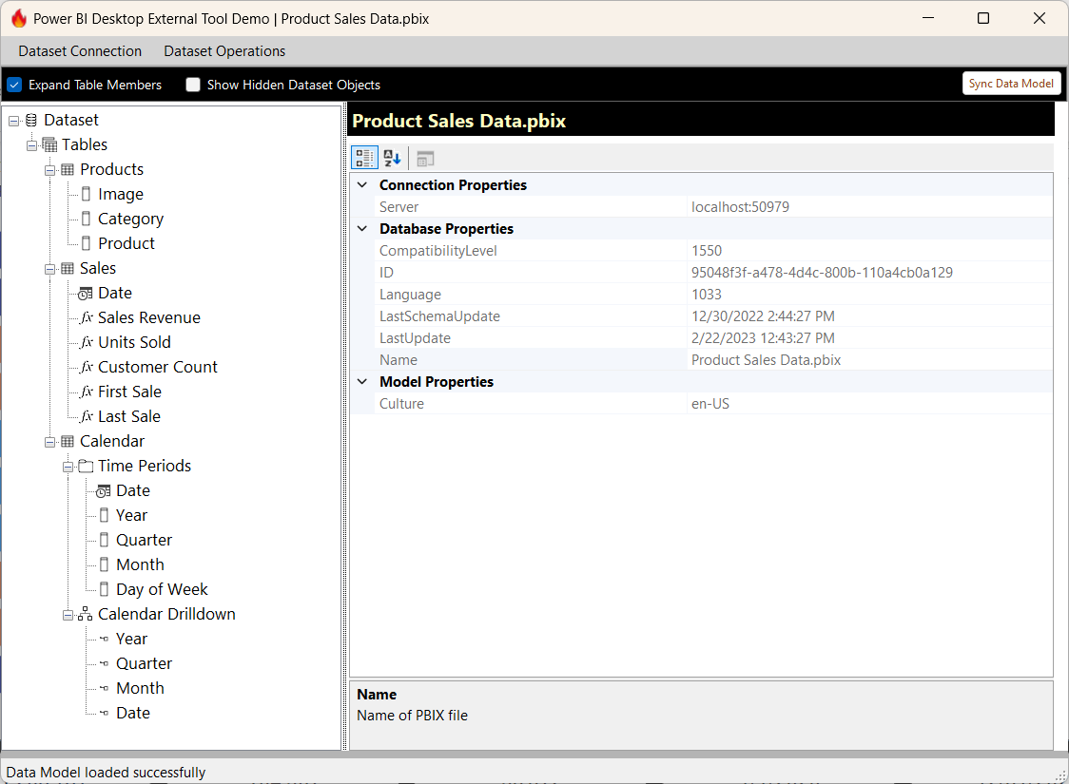
Enumerating Dataset Objects using TOM
Canonical TOM programming pattern for enumerating dataset objects
Create outer loop with enumerate through Tables collection of Model object
Create inner loops to enumerate through child collections
This is approach used to populate treeview

Slide 24
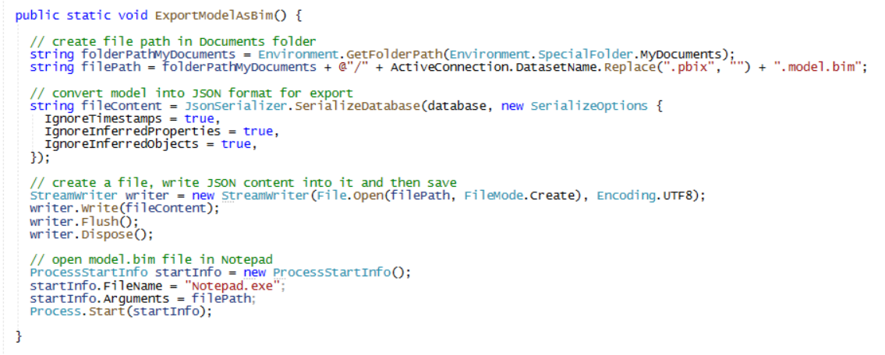
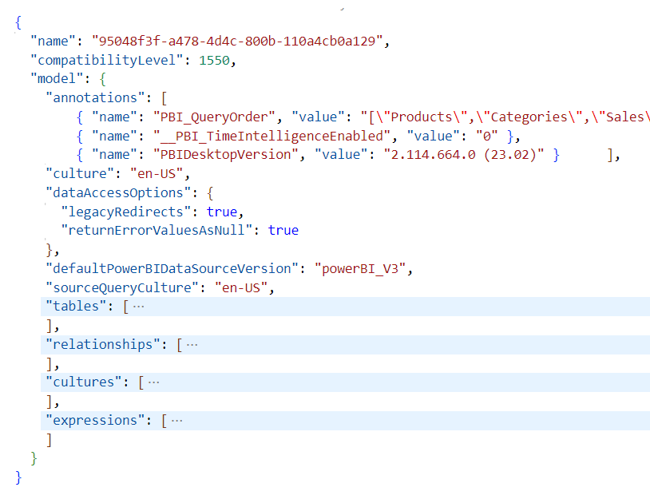
Exporting Dataset Definition as a Model.bim File
TOM provides JsonSerializer object to serialize dataset definition
Makes it possible to export dataset definition as a JSON file
JSON file with dataset definition saved as model.bim file by convention
Looking at model.bim file makes it easier to understand data model and find problems
Product Sales.model.bim

Slide 25
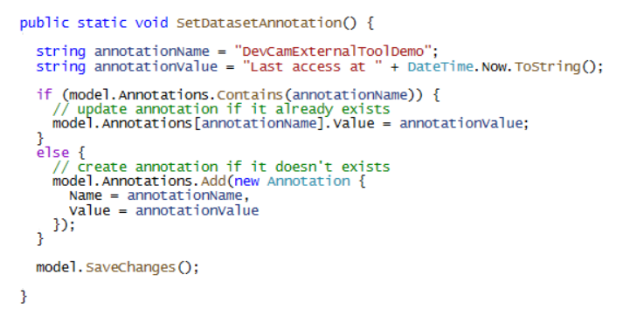
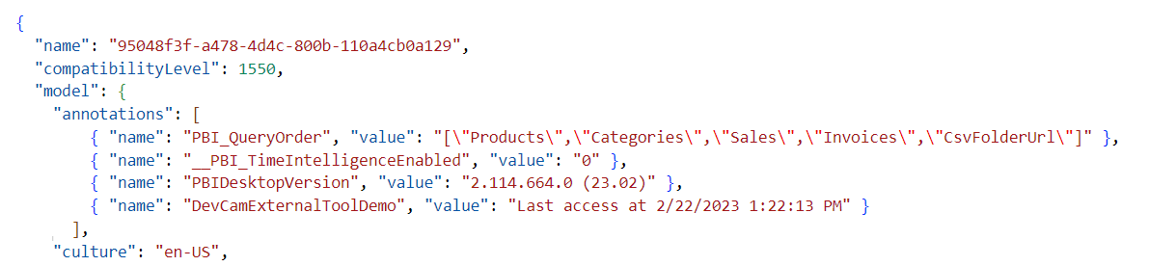
Understanding Dataset Annotations
Annotations provide ability to store custom properties in dataset definition
Annotations are easy to create as name-value pairs using TOM
Annotation can be used to create custom attributes for any type of dataset object

Slide 26
Agenda
Developing External Tools for Power BI Desktop
Programming the Tabular Object Model (TOM)
Adding Productivity Features to an External Tool
Extending Translations Builder

Slide 27
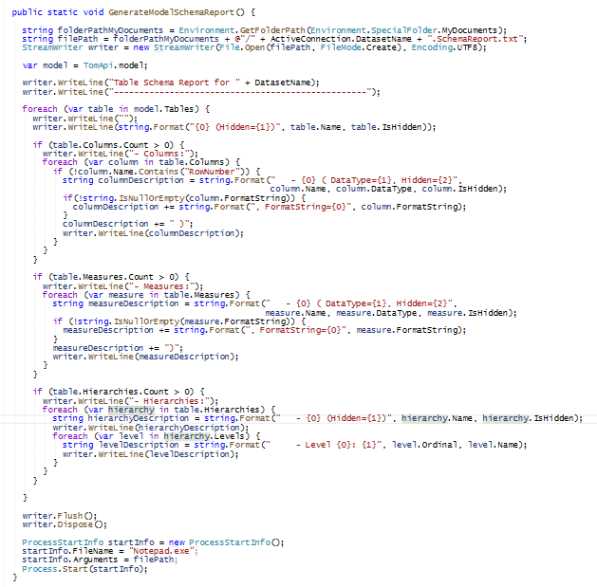
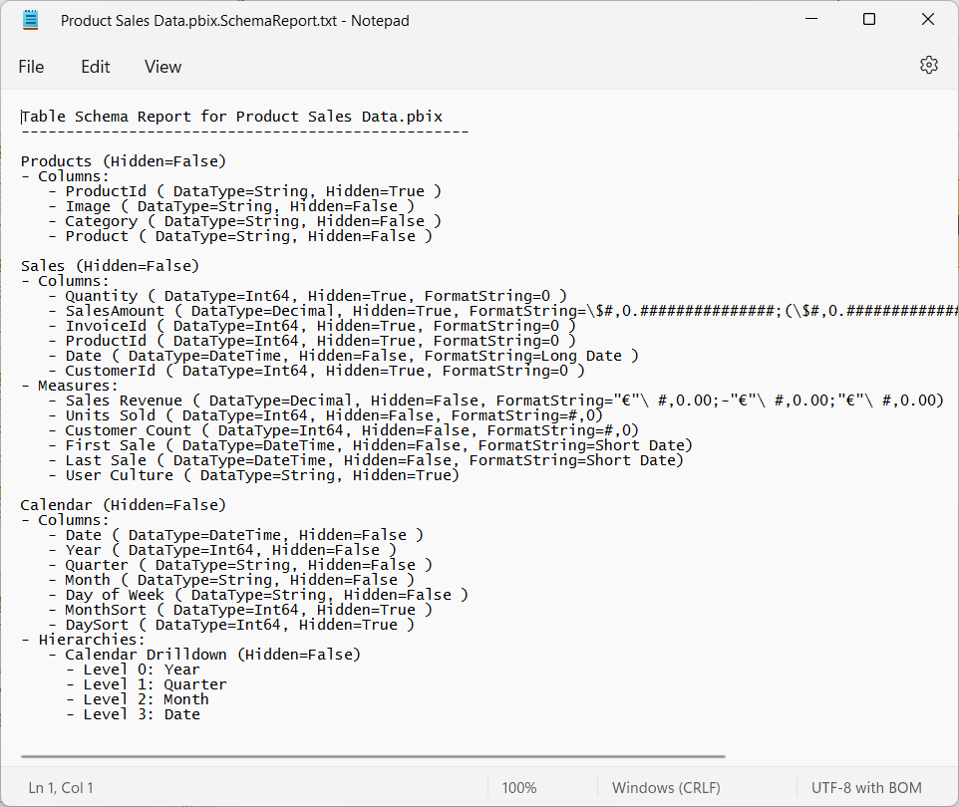
Generate Data Model Schema Report

Slide 28
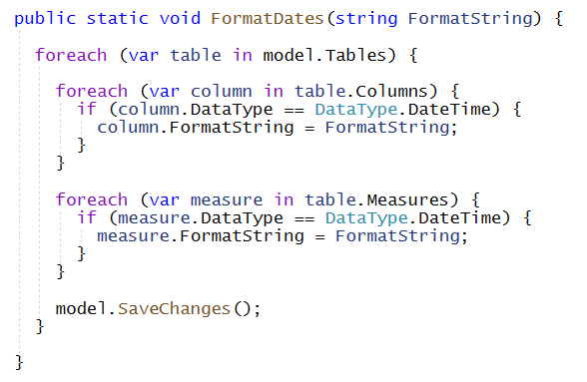
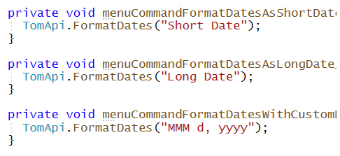
Updating Format String for All DateTime Fields
FormatDates function updates all DateTime fields with specific format string
FormatDates called from menu commands in demo external tool

Slide 29
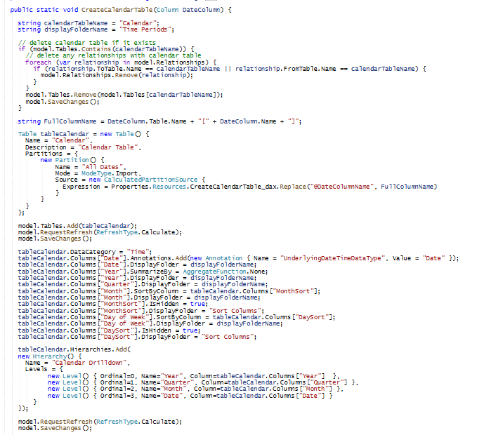
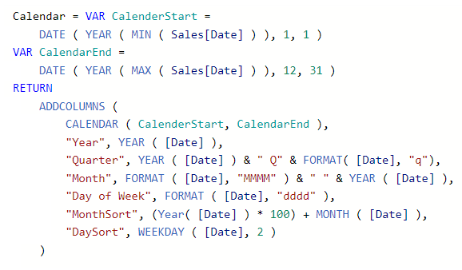
Create Calendar Table from Date Column

Slide 30
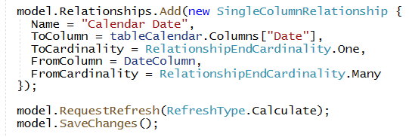
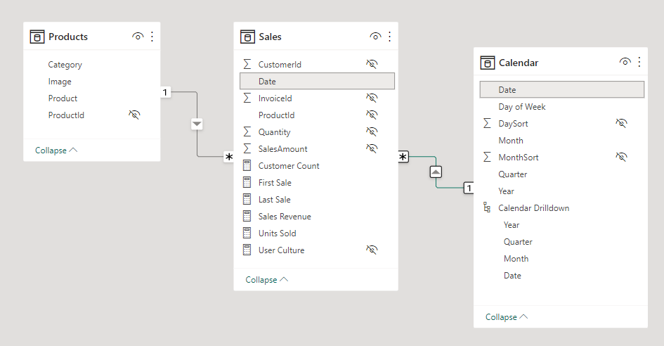
Integrating Calendar Table into Data Model
TOM makes it possible to create table relationships

Slide 31
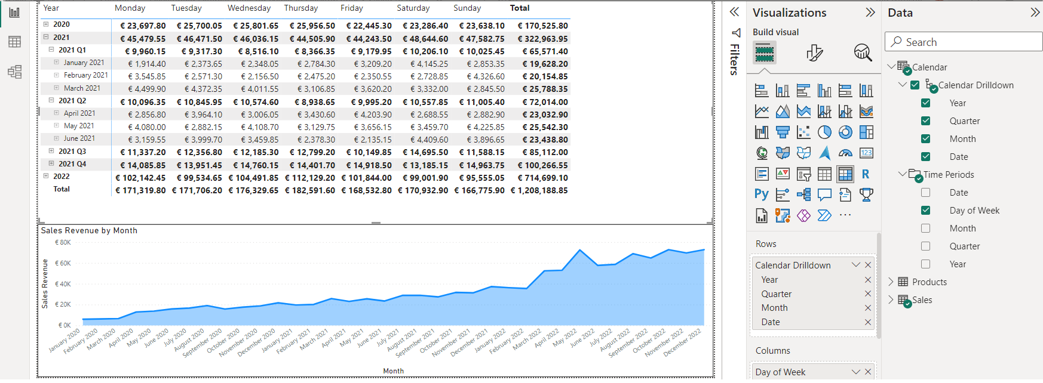
Working with Calendar Table in Report View

Slide 32
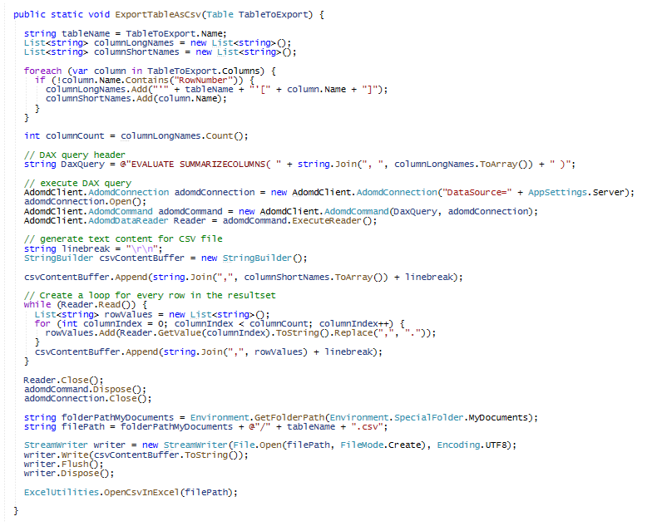
Execute DAX query using adomdClient
Generate CSV content using StringBuilder
Enumerate rows in DAX query result
Generate CSV File and Open in Excel

Slide 33
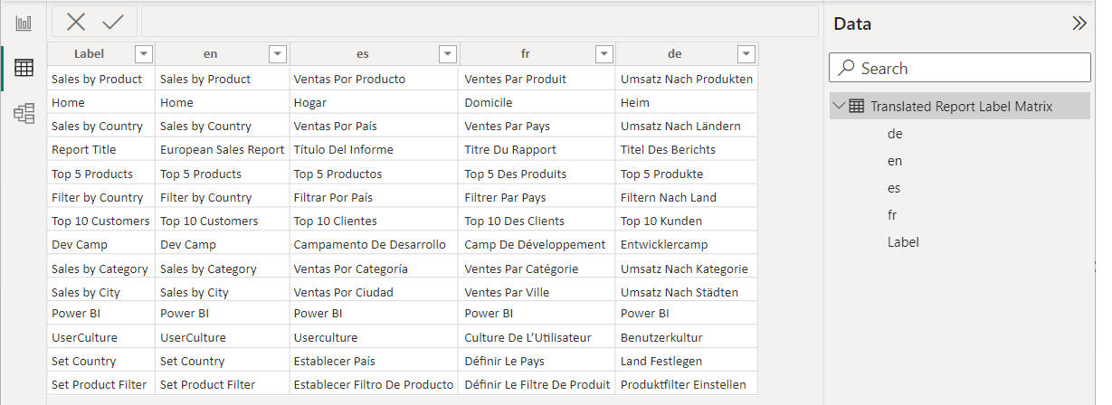
Generate Translated Report Labels
Requirement: write code to generate a set of measures for report label translation
Measures will look up translations from imported table named Translated Report Label Matrix
Measures will be generated with USERCULTURE to retrieve translations for user’s language
TOM code uses adomdClient to execute DAX query against dataset and return JSON result
TOM code generates measures on the fly by reading data in Translated Report Label Matrix

Slide 34
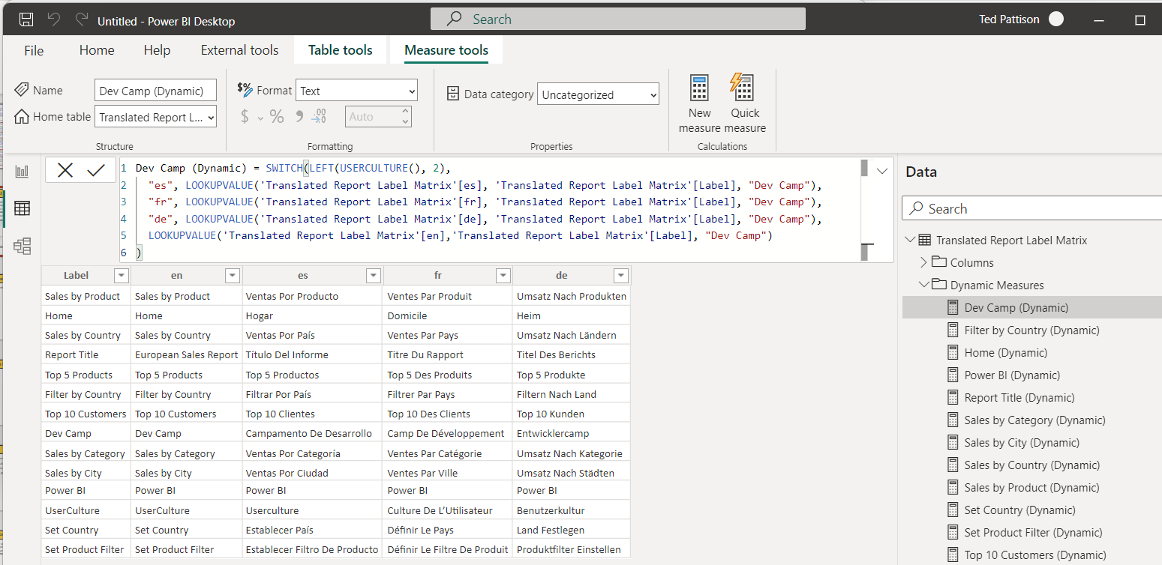
Generating Measures with Dynamic Lookups

Slide 35
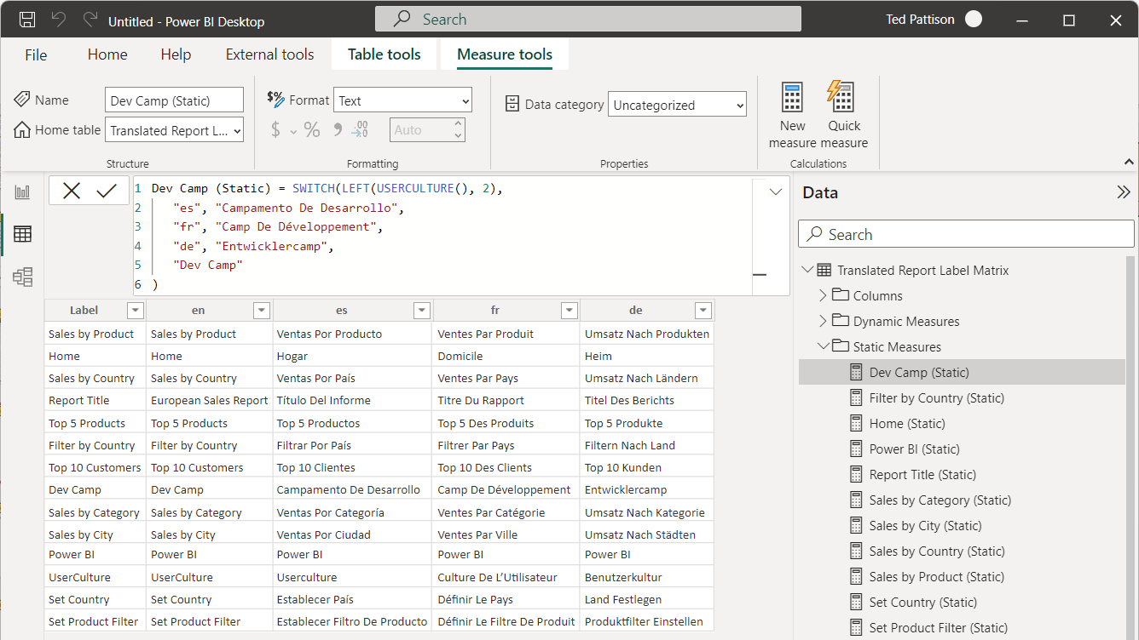
Generating Measures with Static Lookups

Slide 36
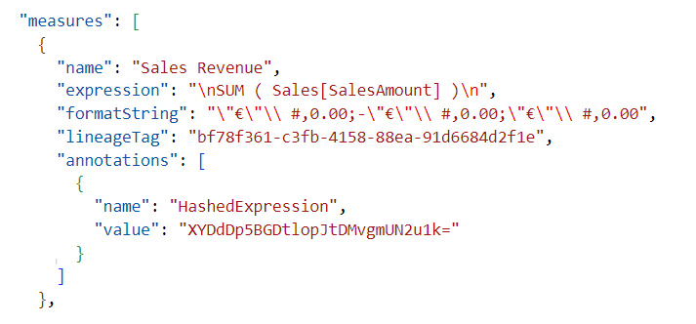

Format DAX Expressions using DAX Formatter API
Requirement: reformat all DAX expressions in data model using DAX Formatter API
DAX Formatter API provided by SQLBI – thanks!
Requires .NET code to execute HTTP requests and manage HTTP responses
TOM code uses HashedExpression annotations to track which DAX expressions already formatted
HashedExpression annotation value generated using SHA1 class in .NET 6 core library

Slide 37
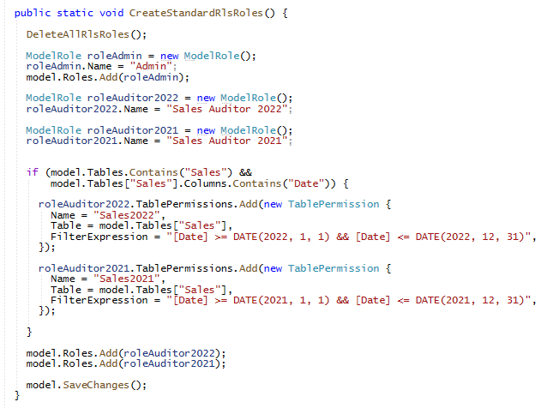
Using TOM To Create RLS Roles

Slide 38
Agenda
Developing External Tools for Power BI Desktop
Programming the Tabular Object Model (TOM)
Adding Productivity Features to an External Tool
Extending Translations Builder

Slide 39
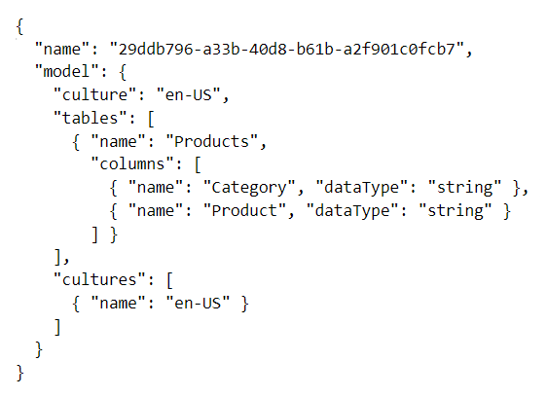
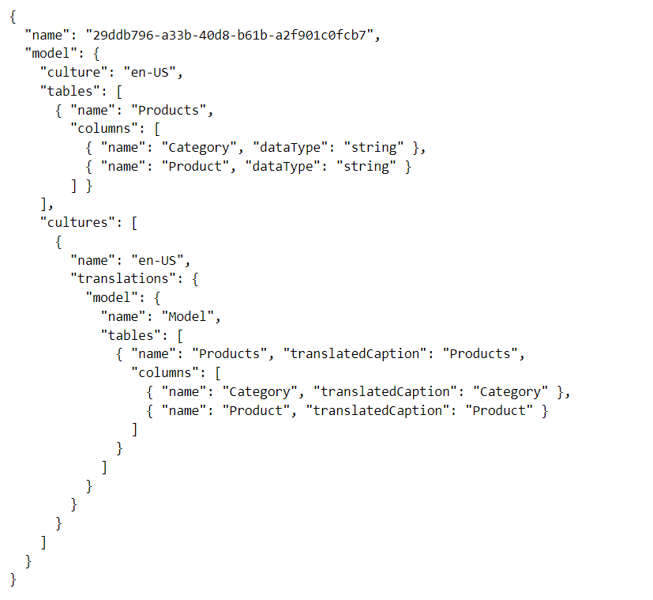
Adding Metadata Translations
When you create a new PBIX project…
It has a default culture (en-US)
You must add new cultures for secondary languages and then add metadata translations
Model
Table
Column
Measure
Hierarchy
Cultures
Culture
Table
Column
Measure
Hierarchy

Slide 40

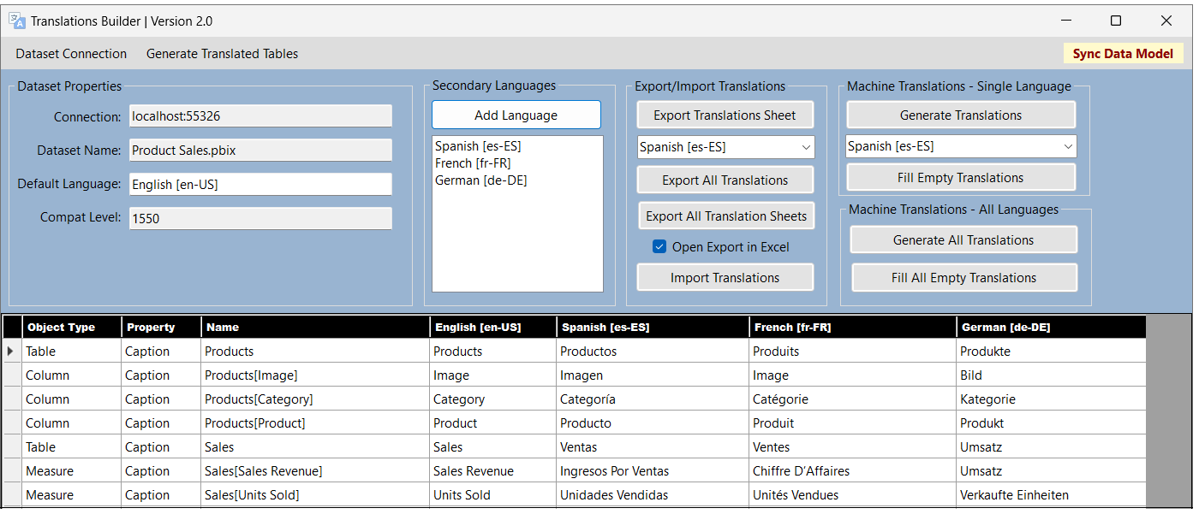
Working with Metadata Translations
Power BI Desktop does not expose metadata translations
It provides no capability to view, add or edit metadata translations
What are your options for working with metadata translations?
Use Tabular Editor to manually add and edit translations
Write scripts for Tabular Editor
Develop custom application with C# and Tabular Object Model (TOM)
Use Translations Builder – it was designed specifically to play this role

Slide 41
Translations Builder 2.0
Translations Builder is tool designed for content creators using Power BI Desktop
Content creators can use this tools to add multi-language support to PBIX project files
Provides support for working with (1) metadata translations and (2) report label translations
Source code available on GitHub: https://github.com/PowerBiDevCamp/TranslationsBuilder

Slide 42
Summary
Developing External Tools for Power BI Desktop
Programming the Tabular Object Model (TOM)
Adding Productivity Features to an External Tool
Extending Translations Builder

